Slide 1
Processes (فرآیند)
Hamid R. Zarandi
h_zarandi@aut.ac.ir

Slide 2
Definition
Process
A program in execution; process execution must progress in sequential fashion
In time-sharing sys: unit of work
All processes are executed concurrently
Process vs. Job?
Passive: program
Active: process
Program becomes process when executable file loaded into memory
One program can be several processes
Question?
java program

Slide 3
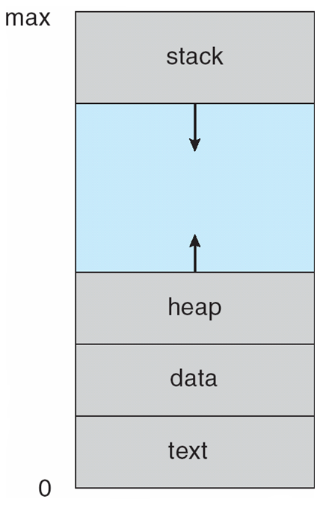
Process in memory

Slide 4
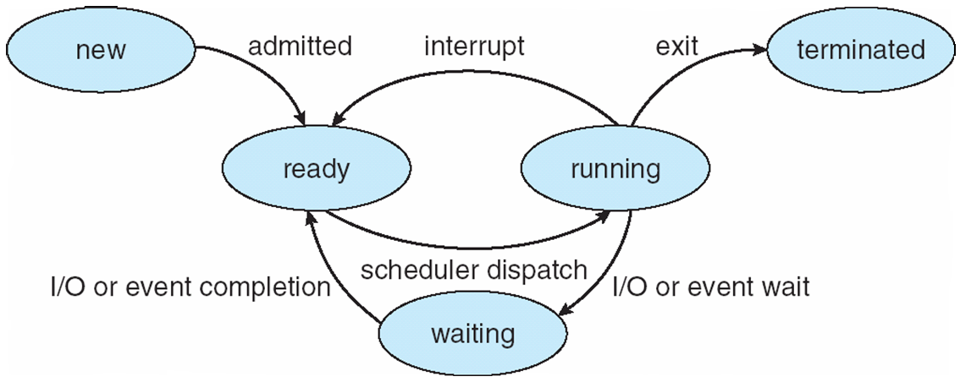
Process state
As a process executes, it changes state
new: The process is being created
running: Instructions are being executed
waiting: The process is waiting for some event to occur
ready: The process is waiting to be assigned to a processor
terminated: The process has finished execution

Slide 5
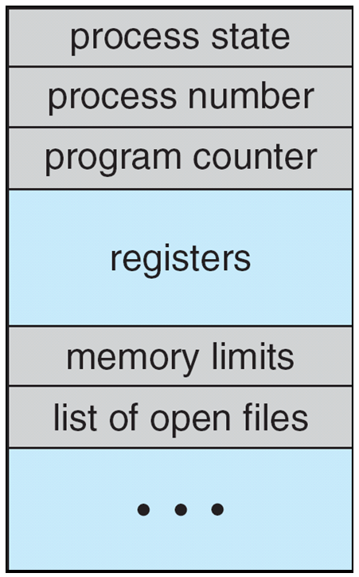
Process Control Block (PCB)
How to manage processes?
Information associated with each process
(also task control block)
Process state
Program counter
CPU registers – contents of all process-centric registers
CPU scheduling info. – priorities, scheduling queue pointers
Memory-management info. – memory allocated to the process
Accounting info. – CPU used, clock time elapsed since start, time limits
I/O status info. – I/O devices allocated to process, list of open files

Slide 6
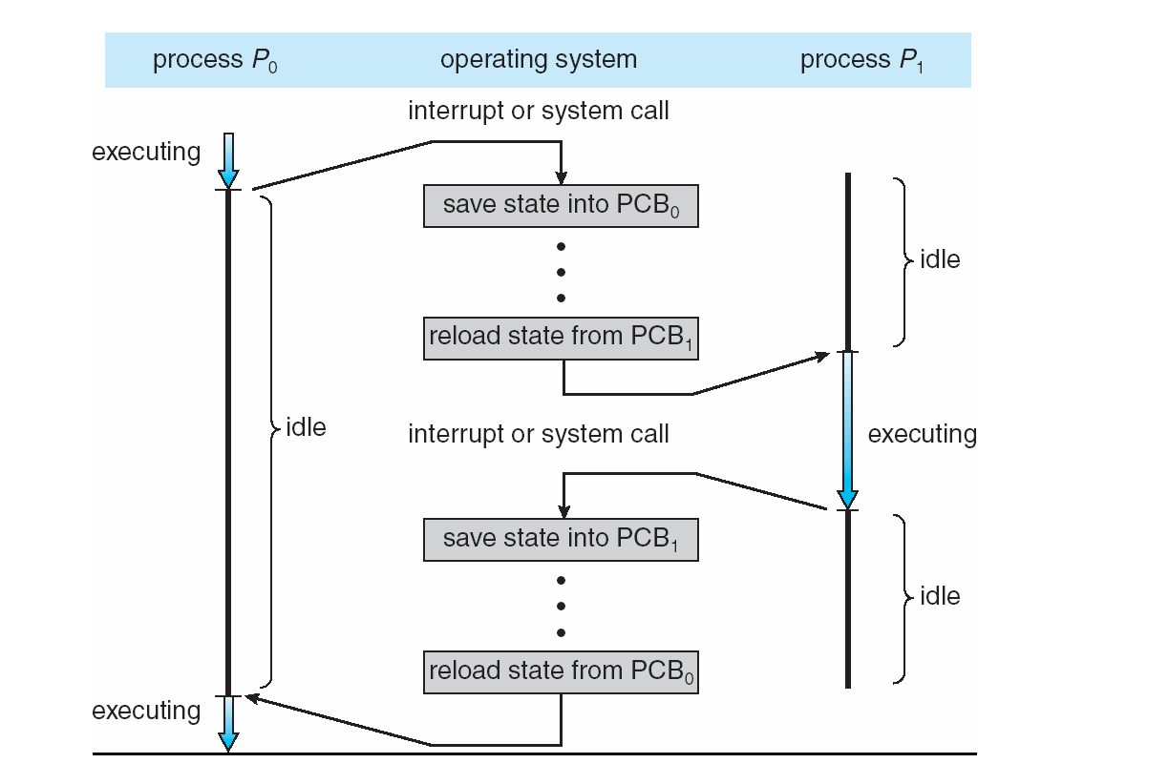
CPU switch from process to process

Slide 7
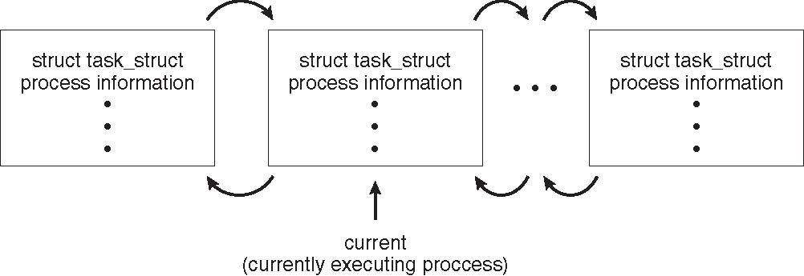
Process representation in Linux
Represented by the C structure task_struct
pid t_pid; /* process identifier */ long state; /* state of the process */ unsigned int time_slice /* scheduling information */ struct task_struct *parent; /* this process’s parent */ struct list_head children; /* this process’s children */ struct files_struct *files; /* list of open files */ struct mm_struct *mm; /* address space of this process */

Slide 8
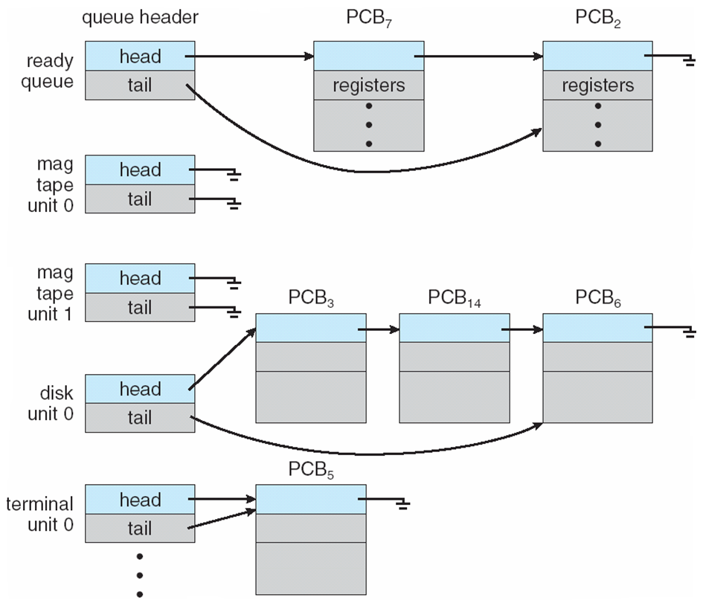
Process scheduling
Process scheduler selects among available processes for next execution on CPU

Slide 9
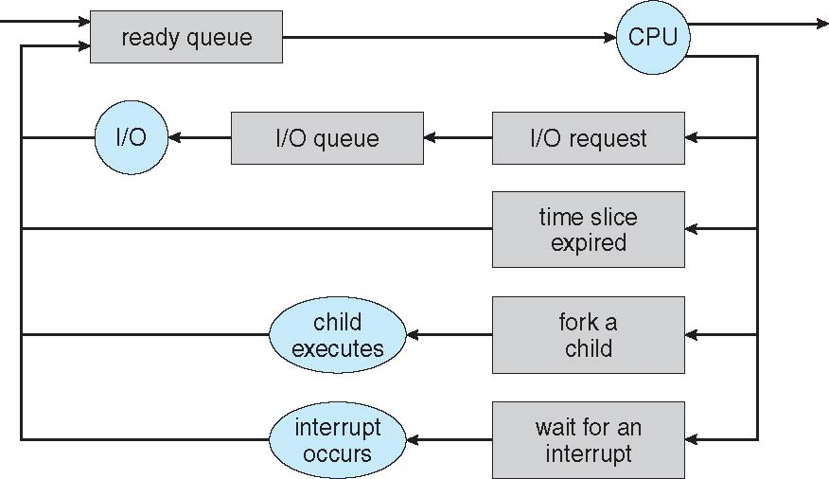
Diagram representation of process scheduling
Queueing diagram represents queues, resources, flows

Slide 10
Schedulers
Short-term scheduler (or CPU scheduler)
selects which process should be executed next and allocates CPU
Sometimes the only scheduler in a system
Short-term scheduler is invoked frequently (milliseconds) ⇒ (must be fast)
Long-term scheduler (or job scheduler)
selects which processes should be brought into the ready queue
Long-term scheduler is invoked infrequently (seconds, minutes) ⇒ (may be slow)
The long-term scheduler controls the degree of multiprogramming
Processes:
I/O-bound
spends more time doing I/O than computations, many short CPU bursts
CPU-bound
spends more time doing computations; few very long CPU bursts
Long-term scheduler strives for good process mix

Slide 11
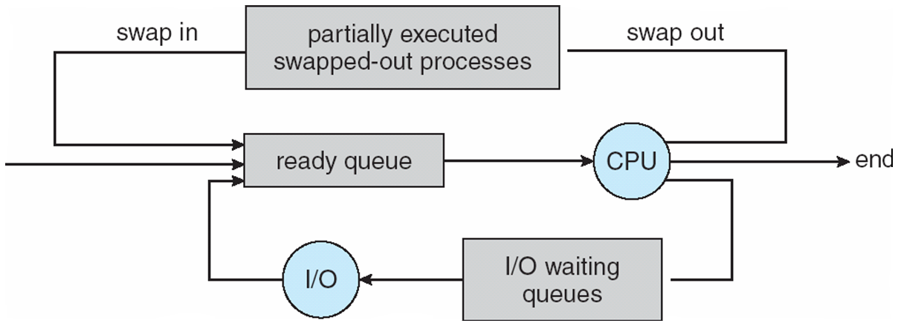
Example of standard API
Medium-term scheduler
Can be added if degree of multiple programming needs to decrease
Remove process from memory, store on disk, bring back in from disk to continue execution: swapping

Slide 12
Context switch (تعویض متن)
When CPU switches to another process, the system must save the state of the old process and load the saved state for the new process via a context switch
Context of a process represented in the PCB
Context-switch time is overhead; the system does no useful work while switching
The more complex the OS and the PCB ➔ the longer the context switch
Time dependent on hardware support
Some hardware provides multiple sets of registers per CPU ➔ multiple contexts loaded at once

Slide 13
Process creation
Parent vs. Child
Generally, process identified and managed via a process identifier (pid)
Resource sharing options
Parent and children share all resources
Children share subset of parent’s resources
Parent and child share no resources
Execution options
Parent and children execute concurrently
Parent waits until children terminate

Slide 14
A tree of processes in Linux

Slide 15
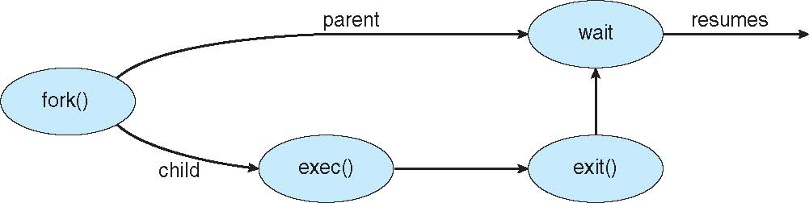
Process creation
Address space
Child duplicate of parent
Child has a program loaded into it
UNIX examples
fork() system call creates new process
exec() system call used after a fork() to replace the process’ memory space with a new program

Slide 16
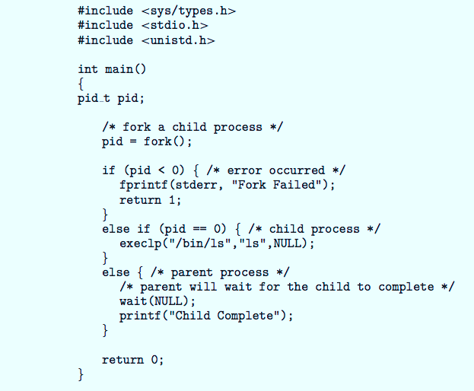
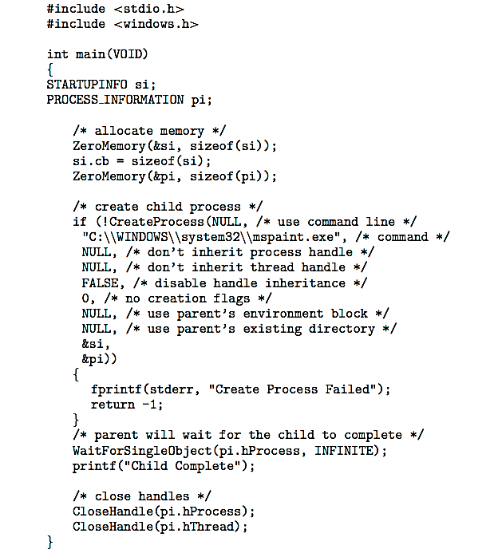
Process creation with C
POSIX
Windows

Slide 17
Process termination
Child → Parent
Process’ resources are deallocated when:
exit(n)
return() in main()
Catch exit status → wait()
pid = wait(&status);
Parent → Child
abort()
Why?
Child has exceeded allocated resources
Task assigned to child is no longer required
The parent is exiting and the operating systems does not allow a child to continue if its parent terminates

Slide 18

Problems of process termination
zombie process
No parent waiting
orphan process
Parent termination without wait
Multi process example: Chrome Browser
Browser, Renderer, Plugins, etc

Slide 19
Interprocess communication (IPC)
Process:
independent vs. cooperating
Cooperating process:
Shared memory
Message passing

Slide 20
Circular buffer & producer-consumer problem
#define BUFFER_SIZE 10
typedef struct {
. . .
} item;
item buffer[BUFFER_SIZE];
int in = 0;
int out = 0;
item next_produced;
while (true) {
/* produce an item in next produced */
while (((in + 1) % BUFFER_SIZE) == out)
; /* do nothing */
buffer[in] = next_produced;
in = (in + 1) % BUFFER_SIZE;
}
item next_consumed;
while (true) { while (in == out) ; /* do nothing */
next_consumed = buffer[out];
out = (out + 1) % BUFFER_SIZE;
/* consume the item in next consumed */
}

Slide 21
Message passing
Direct communication (unidirectional)
send (P, message) – send a message to process P
receive(Q, message) – receive a message from process Q
Indirect communication (uni & bidirectional)
Messages are directed and received from mailboxes (or ports)
Can be used by multiple processes
Primitives are defined as:
send(A, message) – send a message to mailbox A
receive(A, message) – receive a message from mailbox A

Slide 22
Synchronization
Blocking vs. non-blocking
Blocking is considered synchronous
Blocking send
Blocking receive
Non-blocking is considered asynchronous
Non-blocking send
Non-blocking receive
The receiver receives
A valid message
Null message
Different combinations possible
If both send and receive are blocking, we have a rendezvous

Slide 23
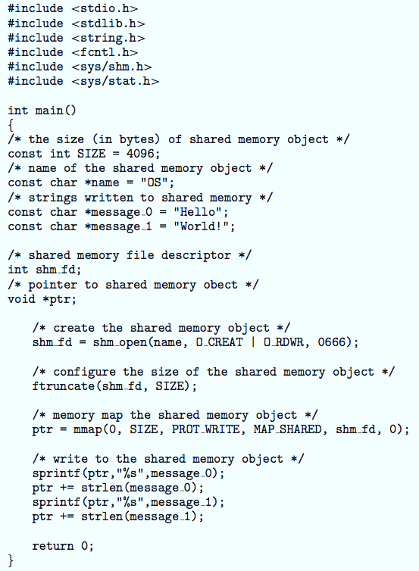
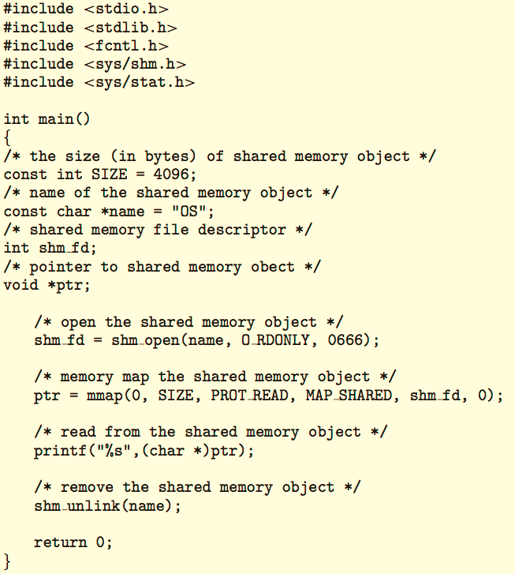
POSIX examples of shared memory: (sender->receiver)

Slide 24
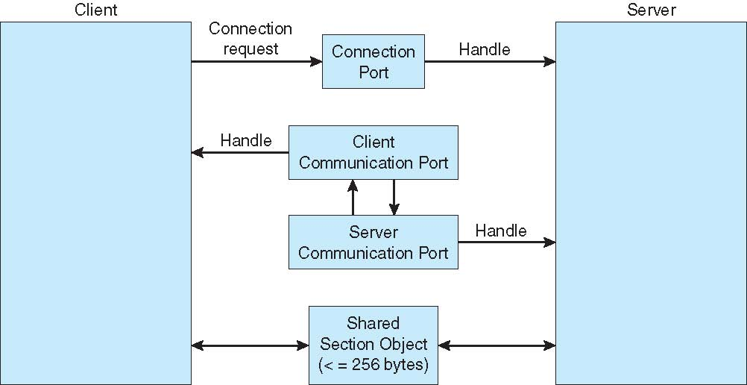
Local procedure calls in Windows

Slide 25
Communications in client-server systems
Sockets
Remote Procedure Calls (windows)
Pipes
Remote Method Invocation (Java)

Slide 26
Sockets
A socket is defined as an endpoint for communication
Concatenation of IP address and port – a number included at start of message packet to differentiate network services on a host
The socket 161.25.19.8:1625 refers to port 1625 on host 161.25.19.8
Communication consists between a pair of sockets
All ports below 1024 are well known, used for standard services
Special IP address 127.0.0.1 (loopback) to refer to system on which process is running

Slide 27
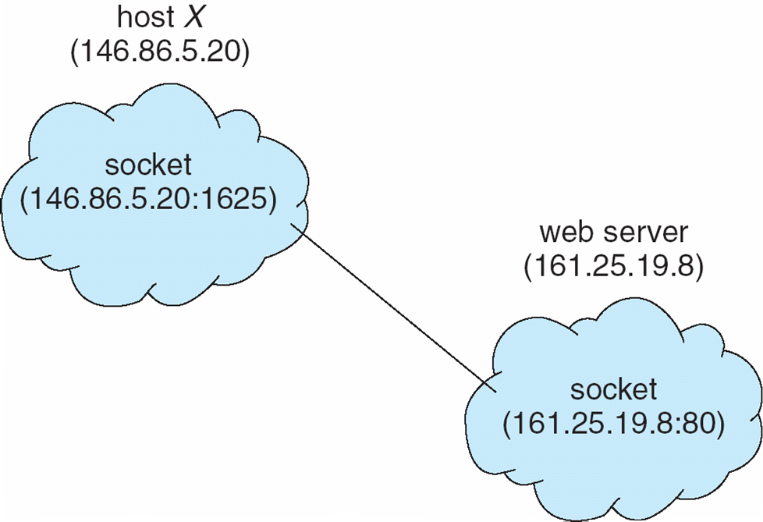
Socket communication

Slide 28
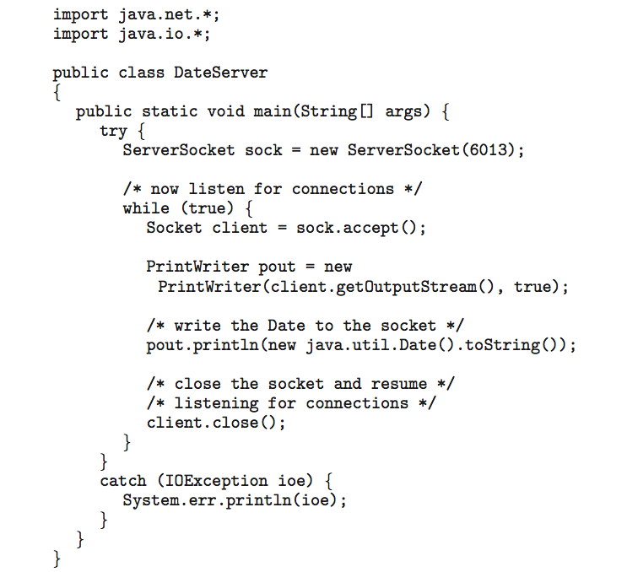
Sockets in Java
Three types of sockets
Connection-oriented (TCP)
Connectionless (UDP)
MulticastSocket class– data can be sent to multiple recipients
Consider this “Date” server:

Slide 29
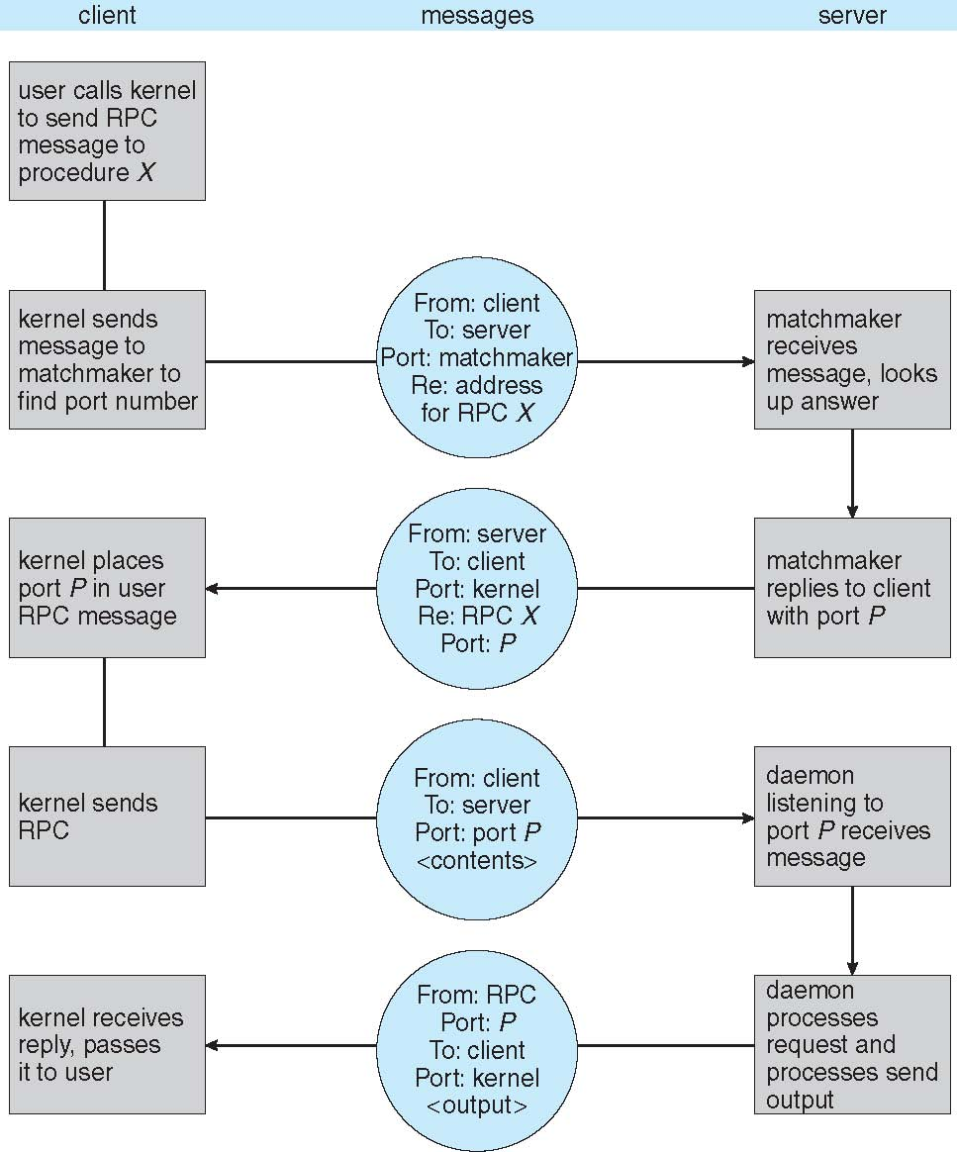
Execution of RPC (Remote Procedure Call)

Slide 30
Pipes
Acts as a conduit allowing two processes to communicate
Issues:
Is communication unidirectional or bidirectional?
In the case of two-way communication, is it half or full-duplex?
Must there exist a relationship (i.e., parent-child) between the communicating processes?
Can the pipes be used over a network?
Ordinary pipes
cannot be accessed from outside the process that created it. Typically, a parent process creates a pipe and uses it to communicate with a child process that it created.
Named pipes
can be accessed without a parent-child relationship.

Slide 31
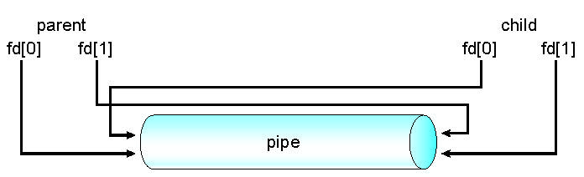
Ordinary Pipes
Ordinary Pipes allow communication in standard producer-consumer style
Producer writes to one end (the write-end of the pipe)
Consumer reads from the other end (the read-end of the pipe)
Ordinary pipes are therefore unidirectional
Require parent-child relationship between communicating processes
Windows calls these anonymous pipes
See Unix and Windows code samples in textbook

Slide 32
Ordinary pipe (POSIX), parent-child

Slide 33
Ordinary pipe (windows), parent

Slide 34
Ordinary pipe (windows), child

Slide 35
Named pipes
Named Pipes are more powerful than ordinary pipes (?)
Communication is bidirectional
No parent-child relationship is necessary between the communicating processes
Several processes can use the named pipe for communication
Provided on both UNIX and Windows systems

Slide 36

Questions?

